Slide 1
AI-based Handwriting to Text Conversion
RA2211033010075 – Kapilan S
RA2211033010082 – Hari Priya T
RAA2211033010108 – Praneeswaran S
RA2211026010400 – Anushtika S U

Slide 2
Aim and Focus
Objective
Key Benefits
Technology Focus
To develop a solution that converts handwritten text into editable digital text using AI.
Enhances productivity by digitizing handwritten content quickly.
Reduces errors in manual transcription.
Can be applied in a variety of industries such as education, healthcare, and finance
Machine Learning (ML)
Optical Character Recognition (OCR)
Natural Language Processing (NLP)
Kubernetes
ansible

Slide 3
ABSTRACT
Handwritten text digitization is essential for improving efficiency in various industries like education, healthcare, and finance. This project develops an AI-powered system to accurately convert handwritten text into digital format, addressing limitations of traditional OCR systems. It utilizes CNN for image preprocessing, RNN/LSTM for character recognition, and NLP for error correction to enhance accuracy. Built with TensorFlow, OpenCV, and Tesseract, the system ensures robust text recognition across diverse handwriting styles. By reducing manual transcription effort and minimizing errors, this solution provides a scalable, cloud-based approach for seamless handwriting-to-text conversion, making document digitization more accessible and efficient.

Slide 4
Gap Identification
Traditional Optical Character Recognition (OCR) systems struggle with messy, cursive, or diverse handwriting styles, leading to frequent errors in digitization. Existing solutions often lack contextual understanding, making accurate transcription difficult, especially for non-standard scripts. Additionally, there is a lack of user-friendly and scalable tools that can efficiently convert handwritten text into editable digital formats with minimal errors. Current methods also fail to incorporate real-time corrections using NLP, limiting their accuracy. This project addresses these gaps by integrating CNN, RNN/LSTM, and NLP techniques to enhance recognition accuracy, making handwriting-to-text conversion more efficient, scalable, and user-friendly.

Slide 5
Novelty of the project
This project introduces an AI-driven handwriting recognition system that surpasses traditional OCR limitations by integrating deep learning (CNN, RNN/LSTM) and NLP-based post-processing for enhanced accuracy. Unlike existing solutions, it leverages context-aware corrections to handle diverse handwriting styles, including cursive and non-standard scripts. The cloud-based architecture ensures scalability, making it accessible across various industries. Additionally, advanced image preprocessing techniques improve text extraction from noisy inputs. By combining machine learning, OCR, and NLP, this system provides a highly accurate, automated, and real-time handwriting-to-text conversion solution, setting it apart from conventional approaches.

Slide 6
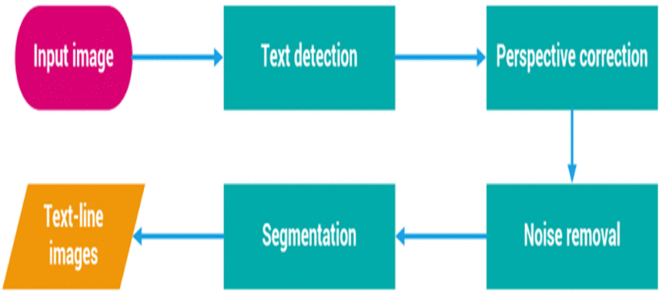
Architecture

Slide 7
How does it work?
Detect the areas of the image that contain text using object detection techniques
Correct errors using NLP models to enhance text accuracy and structure.
Text Detection
Text Post-Processing
1
2
3
4
Image Preprocessing
Character Recognition
Convert scanned handwritten document into a clear image (removing noise, enhancing contrast).
Use an AI model to recognize characters and convert them into digital text.

Slide 8
Technology Stack
AI Models
Libraries and Tools
Infrastructure
Convolutional Neural Networks (CNN) for image preprocessing and text detection.
Recurrent Neural Networks (RNN) and Long Short-Term Memory (LSTM) for handwriting recognition.
TensorFlow/PyTorch (Deep Learning Frameworks)
OpenCV (Image Processing)
Tesseract (OCR Tool)
SpaCy/NLTK (NLP for text post-processing)
Cloud-based (AWS, Azure) for scalable storage and computation.
Python and related libraries for development.

Slide 9
Timeline
Research and Feasibility Study
AI Model Development
Deployment and Maintenance
PHASE 1
PHASE 3
PHASE 5
PHASE 2
PHASE 4
Data Collection and Preprocessing
Integration and Testing

Slide 10
Literature Survey
Title | Authors | Key Findings
Handwritten Text Recognition and Conversion Using Convolutional Neural Network (CNN) Based Deep Learning Model | Jebaveerasingh Jebadurai, I. Praveen Kumar, P. Rajesh, S. Suresh Kumar | Proposed a model that processes images of handwritten text to convert them into digital text using CNN-based deep learning, demonstrating effective recognition capabilities.
A Novel Technique for Handwritten Text Recognition Using EasyOCR | Binod Kumar Pattanayak, Th Bibhuti, Bibhuti Bhusan Dash, Sudhansu Shekhar Patra | Developed an algorithm for recognizing handwritten characters using EasyOCR, emphasizing the practicality and efficiency of integrating existing OCR technologies with deep learning models.
Handwritten Character Recognition Using Convolutional Neural Network | I. Khandokar, Md. M. Hasan, F. Ernawan, Md. S. Islam, M. N. Kabir | Implemented CNNs to recognize characters from image datasets, investigating CNN's capability to recognize characters and the accuracy of recognition with training and testing.

Slide 11
Title | Authors | Key Findings
Real-Time Handwriting Recognition System Using CNN Algorithms | Shir Ley Chooi, Aimi Syamimi Binti Ab Ghafar | Designed an automatic system for handwriting recognition using CNN algorithms, focusing on high performance accuracy and reduced testing time.
Handwritten Text Recognition Using Deep Learning (CNN & RNN) | Rohini G. Khalkar, Adarsh Singh Dikhit, Anirudh Goel, Manisha Gupta | Applied CNNs and Recurrent Neural Networks (RNNs) for handwritten text recognition, highlighting the effectiveness of these models in perceiving the structure of handwritten characters and words.
Handwritten Recognition Techniques: A Comprehensive Review | Kavitha, Srimathi | Reviewed various handwritten recognition techniques, emphasizing the importance of CNNs in automatically extracting characteristics for handwritten character recognition.
In Codice Ratio: OCR of Handwritten Latin Documents Using Deep Convolutional Networks | Donatella Firmani, Marco Maiorino, Paolo Merialdo, Elena Nieddu | Developed a machine-learning software to parse medieval Latin handwriting, achieving 96% accuracy in transcribing documents from the Vatican Apostolic Archive.
Model for Handwritten Recognition Based on Artificial Intelligence | Narumol Chumuang, Mahasak Ketcham | Proposed a general algorithm for more efficient handwritten recognition, aiming to reduce the time required for processing handwritten documents.

Slide 12
Handwritten Text Recognition Using Deep Learning | Authors not specified | Applied deep learning algorithms for handwritten text recognition, highlighting the effectiveness of these models in perceiving the structure of handwritten characters and words.
Artificial Intelligence Based Handwriting Digit Recognition (HDR) | Yogesh Yogesh, G. S. P. Ghantasala, A. Priya | Developed a system capable of recognizing hastily scribbled text and normal handwritten letters, significantly improving the accuracy and capability of handwriting recognition systems.

Slide 13
Thank you

